Slide 1
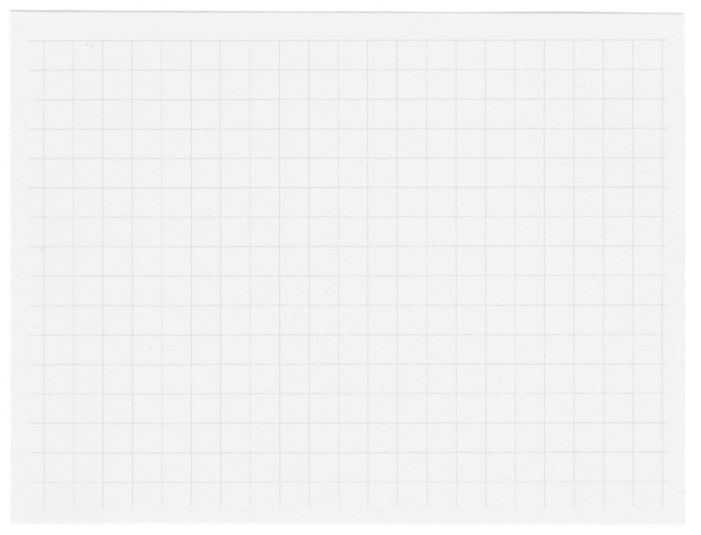













Comparative Study of Web Services Usage in Lille and Nancy
Team Members:
1.Abdulhady Ibrahim 211000768
2.Mohamed adel 202001764
3.Mohamed Ashraf Mohamed 211001445
4.Mohamed samir 221002164
5.Khaled zaki 211001783
6.Mohamed khaled osman 211001922
Dr.Noha Gamal Eldin Saad
Dr.Shaimaa Mohamed Awad

Slide 2
Agenda
04.
Methods employed
01.
Problem definition
05.
02.
Results achieved
Dataset utilized.
06.
03.
Concluding remarks
Preparations and preprocessing

Slide 3
Introduction
This study analyzes web service usage patterns in Lille and Nancy using NETMOB 2023 Challenge data, focusing on service response times and user engagement statistics.

Slide 4

Problem Definition
This project aims to analyze data from Lille and Nancy to evaluate performance and identify spatial patterns and trends in usage patterns of four major web services. The analysis aims to optimize performance, understand user behavior, and improve resource allocation.

Slide 5

Dataset utilized.
The dataset used in this analysis is provided by the NETMOB 2023 Challenge. The dataset includes various metrics such as service response times, user engagement statistics, and other performance indicators. The data spans from April 1, 2019, to April 10, 2019, and is available for both cities across the four web services.

Slide 6

Preparations and preprocessing
1. Data Conversion: The data was initially in 40 text files. These files were converted to CSV format for easier handling and analysis.
2. Data Merging: All individual city and application data files were merged into a single comprehensive CSV file, with additional columns to indicate the day and the application.
3. Data Cleaning: Ensuring consistency and handling any missing values.

Slide 7
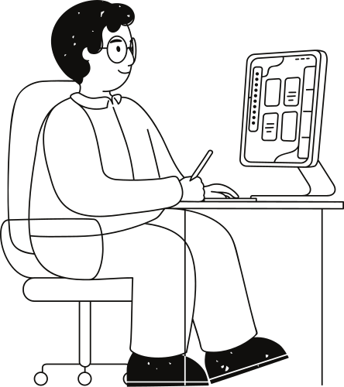
Methods Employed
Exploratory Data Analysis (EDA)
Geo Analysis
Correlation Analysis
Comparative Analysis
Time Series Analysis

Slide 8

Result Achieved
The Project analyzes daily usage patterns of Amazon, Apple, Google, and Microsoft Web Services in Lille and Nancy. Lille shows higher overall usage and more fluctuations, especially for Amazon. Apple and Google exhibit synchronized peaks and declines in both cities. Microsoft usage is relatively stable but drops significantly around early April. Google has the highest total usage in both cities.

Slide 9
Result Achieved
Comparative analysis shows Google Web Services have the highest total usage in both cities, with Lille generally having higher usage overall. Heatmaps indicate higher midday Amazon traffic in Lille, with lower intensity in Nancy. Apple traffic is higher from mid-morning to early evening in Lille, whereas Nancy has lower traffic overall. Google traffic is consistently high in Lille, while Nancy shows less intensity. Microsoft traffic in Lille is sporadic, with defined peaks, while Nancy's usage is more scattered.

Slide 10

Result Achieved
Weekday vs. weekend analysis reveals higher weekday traffic for Amazon, Apple, Google, and Microsoft, suggesting work-related usage. Pie charts of AM vs. PM traffic show significantly higher PM traffic for all services, indicating a preference for evening usage. Correlation matrices show strong correlations among Amazon, Apple, and Google services in both cities, suggesting interconnected usage patterns, while Microsoft shows lower correlations.

Slide 11

Result Achieved
PM traffic is higher than AM traffic in both Lille and Nancy, reflecting more activity in the afternoon and evening. The high correlations among Amazon, Apple, and Google indicate synchronized usage patterns, while Microsoft diverges slightly. These insights are valuable for optimizing resource allocation and user engagement strategies.

Slide 12

• Concluding remarks
The analysis provides valuable insights into the usage patterns and performance of web services in Lille and Nancy. Understanding these patterns can help optimize resource allocation, improve server load management, and enhance user engagement strategies. Future work could involve a deeper analysis of the causes behind observed patterns and extending the study to more cities.

Slide 13
Thank you very much!

